Slide 1


Babak Emami,
Data Scientist Director / AI Architecture
Emami.Babak@gmail.com
647-326-6199
https://github.com/BabakEA/

Slide 2
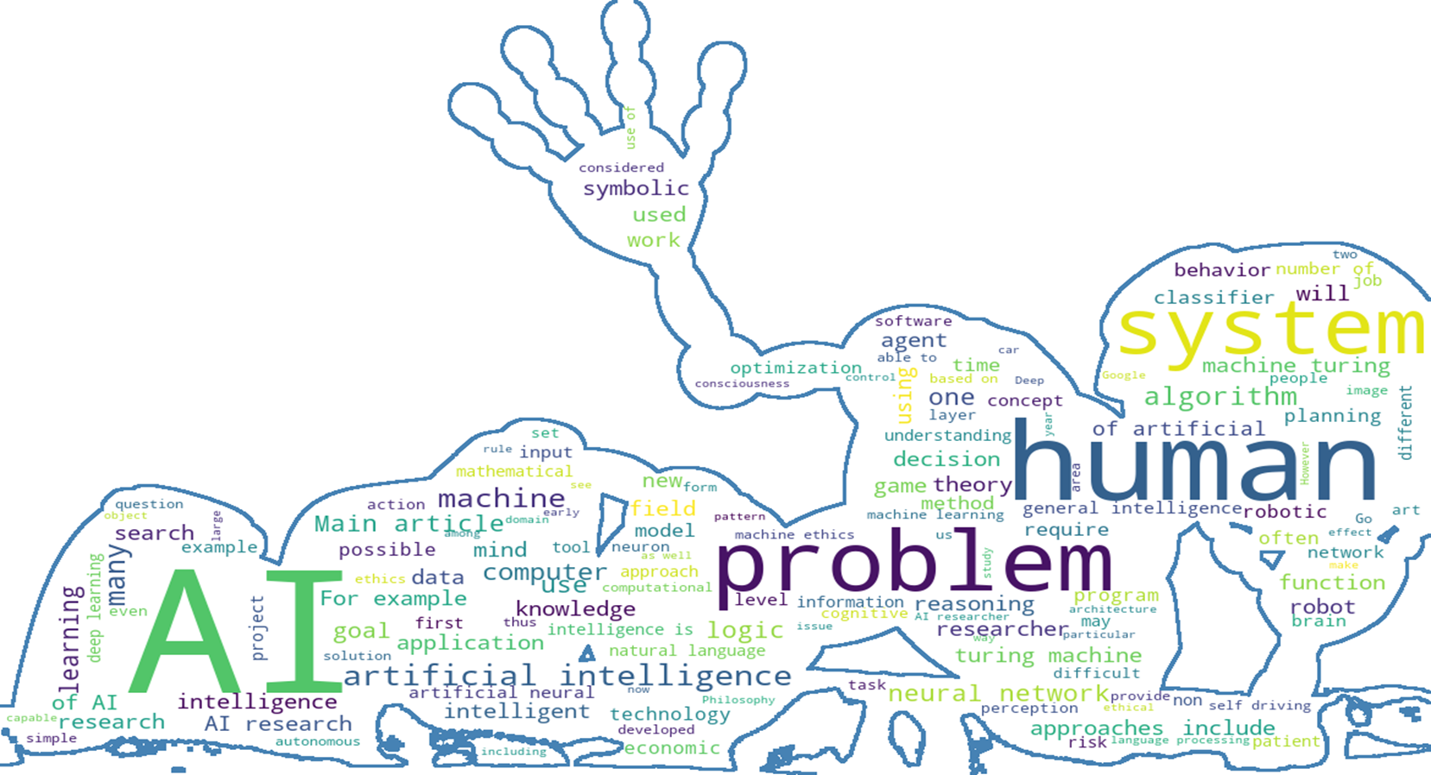
Book Store Virtual Assistant Prototype

Slide 3
Agenda
Introduction: Book Store Chatbot Prototype, a cutting-edge solution designed to enhance user experience in the realm of online bookstores
Methodology : LLM Database API User Interface
Implementation: Implementing a POC using RAG model, Open-AI ( GPT 3.5 ) , Chroma DB
Future Works: How to improve the model efficiency

Slide 4


Introduction : What chatbot ☺
An intelligent chatbot is the perfect virtual assistant for any bookstore or online store, seamlessly guiding customers through a personalized shopping experience, offering expert recommendations, and providing instant support around the clock, ensuring unparalleled convenience and satisfaction.
AI-based Agent:
Efficiency: by automating repetitive and rule-based tasks
Accuracy: minimize the possible human risk
Scalability: AI-based Agent can scale easily to handle large datasets
Real-time Processing: AI-based chatbot can be easily adapt with Data drift and ensures that the data pipeline is always up to date.

Slide 5
Introduction : Data Gathering
Data Collection: The book-related data is stored and managed using Chromadb, a versatile vector database. Upon initialization, the chatbot creates a dedicated collection named "book_store" within Chromadb to store detailed information about each book, including its title, genre, author, and abstract.
General Information Collection: In addition to book-specific data, the chatbot also maintains a collection named "general" within Chromadb. This collection stores essential information such as return policies and purchasing methods, generated using GPT-3.5 with knowledge distillation techniques. This ensures that users can easily access relevant general information during their interactions with the chatbot.
User Activity Logging: To enhance user experience and enable personalized recommendations, the chatbot logs user interactions using SQLite. This "Log_saver" database records user searches, purchases, and other activities, providing valuable insights for refining the recommendation engine and improving overall performance.

Slide 6
Methodology :
Technologies Used:
Chromadb: A powerful vector database used for efficient data storage and retrieval, enabling seamless handling of book-related information.
OpenAI: Utilized for Named Entity Recognition (NER), intention detection, summarization, and question answering, ensuring accurate and context-aware responses.
FastAPI: A high-performance framework used to develop the chatbot's API, facilitating rapid communication between the user interface and backend processes.
SQLite: Employed for data management, logging user interactions, and powering the recommendation engine.

Slide 7


Implementation: Implementing a POC using Open-AI ( GPT 3.5 ) GPT-3.5.
Essential Requirements:
OpenAI API Token: This token serves as the key to connect with the OpenAI platform.
Python 3.9+: A prerequisite for running our AI-based ETL solution.
Fast-API: We have employed Fast-API, to create a user-friendly dashboard and graphical user interface.
Langchain, ChromaDB, Transforms, RASA, : These data manipulation libraries are instrumental for parsing and analyzing datasets.
Engine and Cost Efficiency:
Within our project, we've chosen "text-davinci-003" as our GPT-3.5 model variant, which can effectively handle up to 4000 tokens. For our proof of concept, this variant is more than sufficient. Notably, the cost of utilizing this engine is approximately $0.002 per 1000 tokens, and this cost will be automatically computed and displayed during our live demonstration.

Slide 8
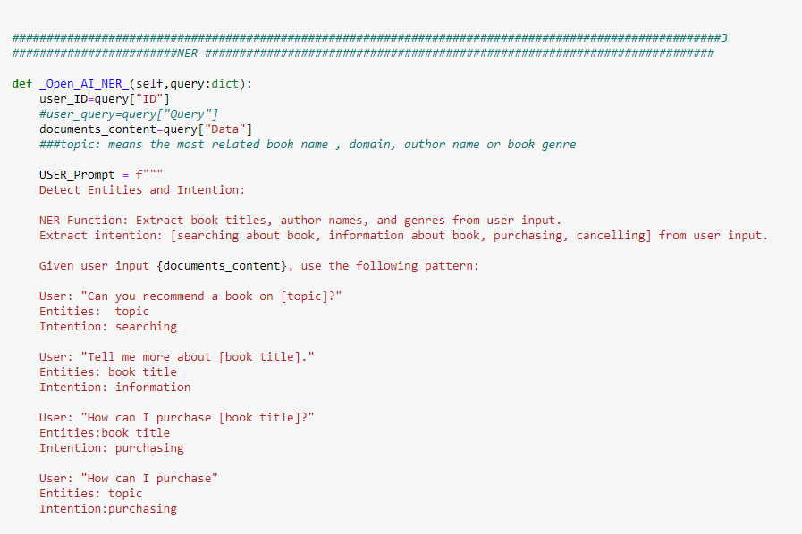
Implementation: Chatbot Functionality
Chatbot Operation: Powered by OpenAI's advanced capabilities, our chatbot offers a seamless and intuitive user experience. Upon receiving a user query, the chatbot employs NER to extract relevant entities and intention detection to discern the user's objective.
Few-Shot Learning: Utilizing few-shot learning techniques, the chatbot continuously improves its understanding of user queries by analyzing a set of sample interactions provided in each query. This adaptive approach enables the chatbot to accurately interpret user intents and provide context-aware responses.

Slide 9
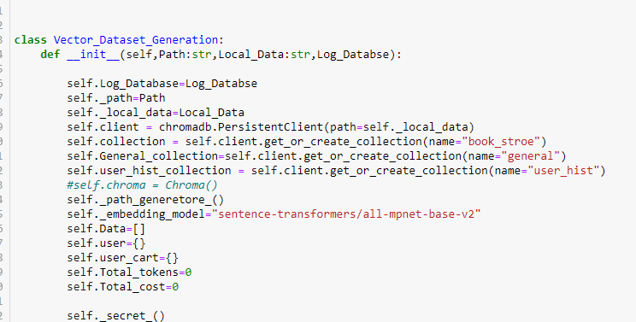
Implementation: Chatbot Functionality
Handling Different Queries:
User initiates conversation with the chatbot via the API.
Chatbot applies NER and intention detection to interpret user query.
Depending on the intention, the chatbot retrieves relevant information from Chromadb or provides general information from the "general" collection.
User activity is logged in the SQLite database for future reference and recommendation.
Recommendation Requests: The chatbot recommends books based on user interests and preferences derived from past interactions.
Information Requests: Detailed information about books, authors, or genres is provided using summarization techniques.
General Inquiries: Users can inquire about return policies, purchasing methods, and other general information stored in the "general" collection

Slide 10

Implementation

Slide 11
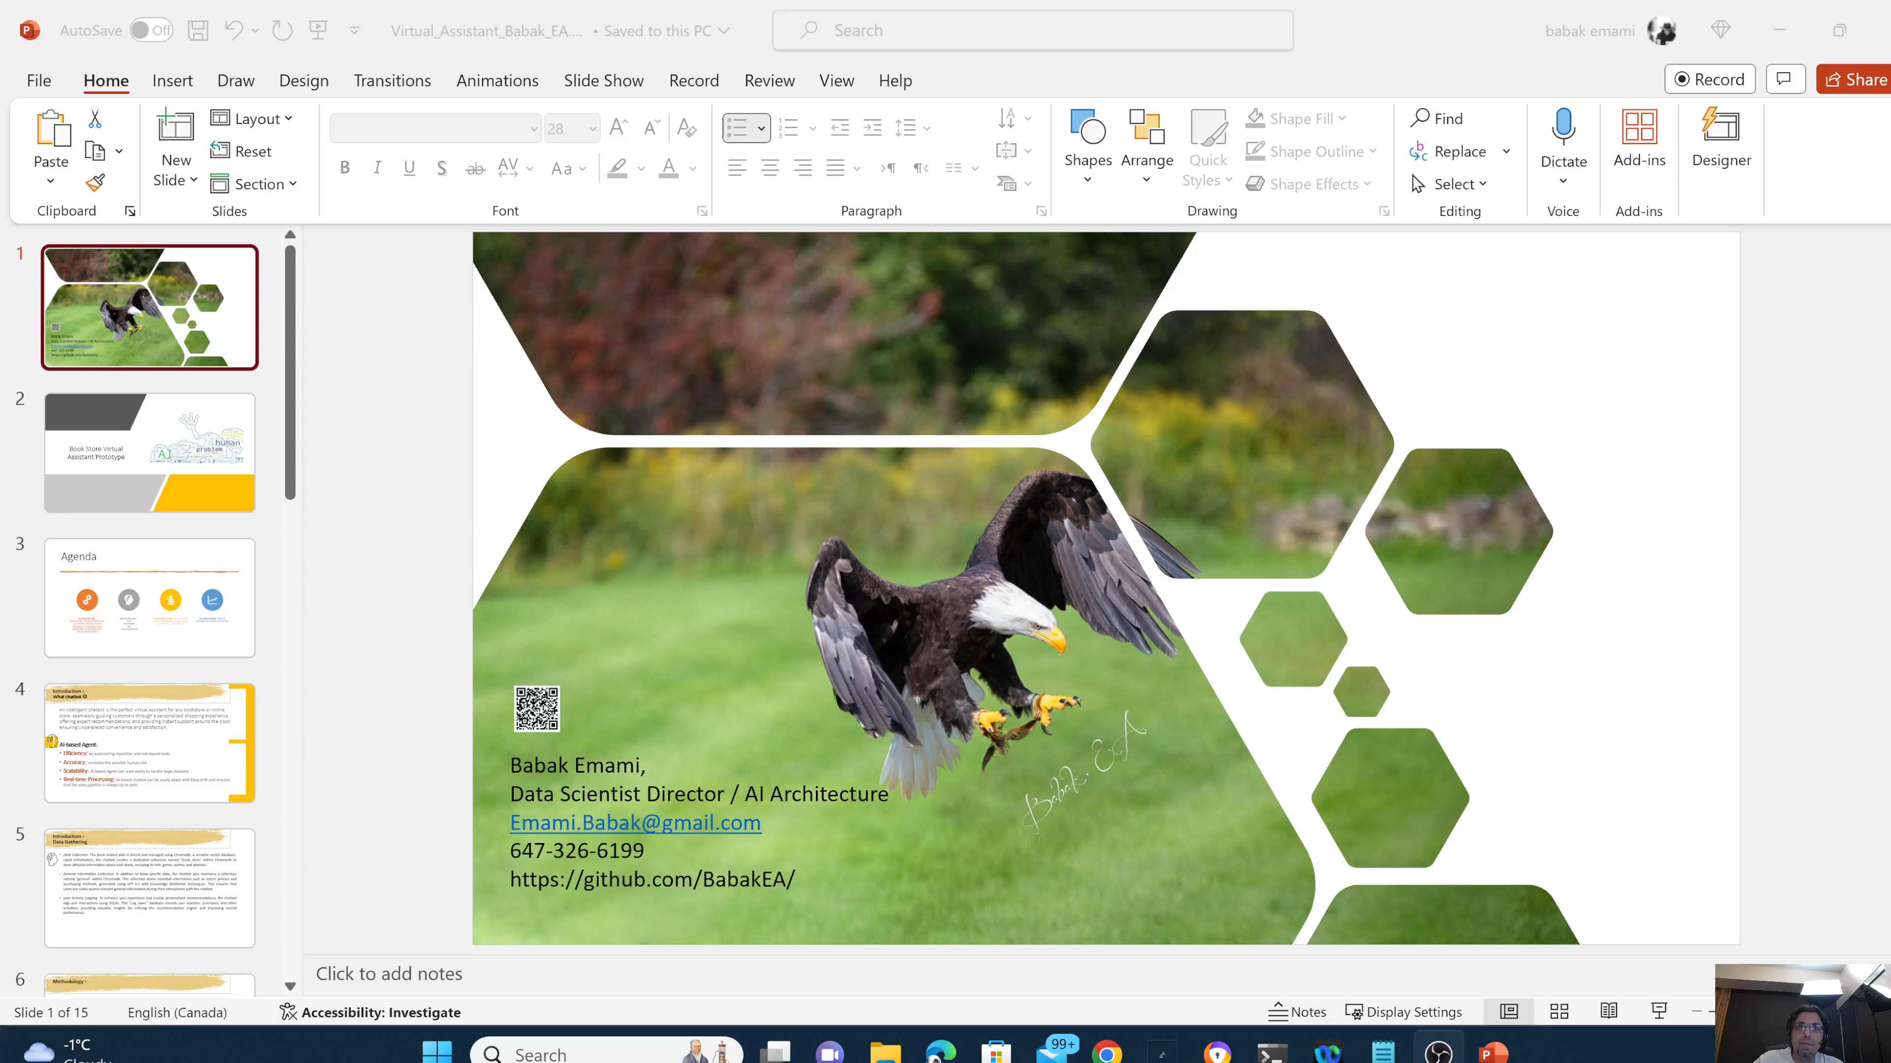
Live Demo. Fast API

Slide 12
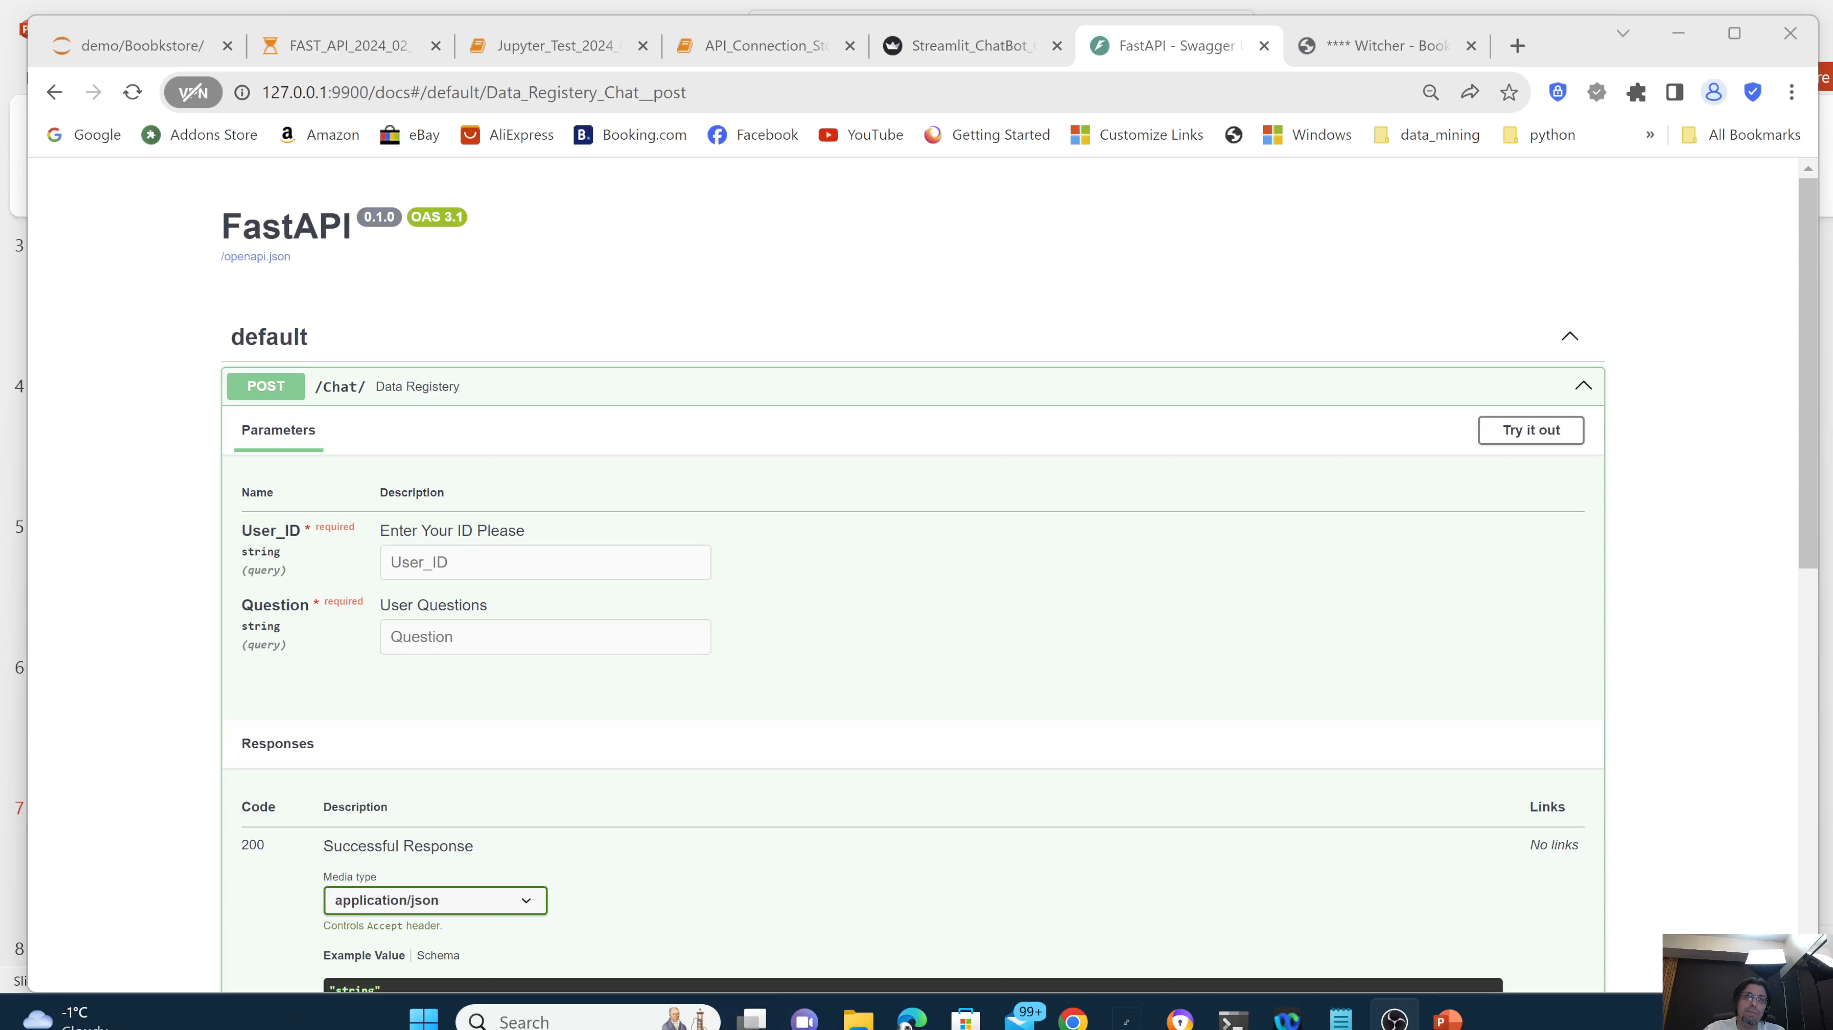
Live Demo. Fast API

Slide 13
Summary
Summary: The Book Store Chatbot Prototype represents a significant advancement in user interaction and recommendation systems within the online bookstore domain. By harnessing the power of advanced technologies such as Chromadb, OpenAI, and SQLite, our chatbot offers a seamless and personalized experience for users, enabling them to discover new books and access relevant information with ease.
Future Directions: As we continue to iterate and refine the chatbot, there are numerous opportunities for enhancement and expansion. This includes refining recommendation algorithms, integrating additional datasets, and exploring new ways to personalize the user experience further. We remain committed to delivering cutting-edge solutions that redefine the online bookstore experience and look forward to your feedback and collaboration in this journey

Slide 14
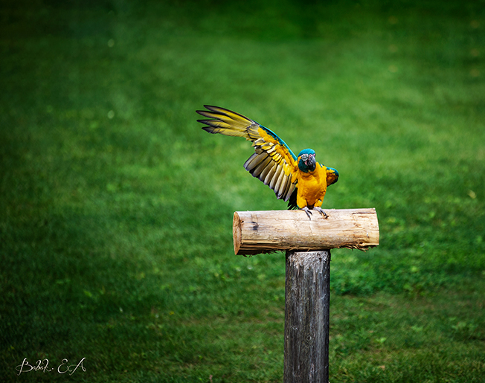
Thank you!

